Slide 1

Azure Functions
Alagunila Meganathan
Founder & CEO- InnovoTree Technologies Microsoft MVP, C# Corner MVP
NilaMeganathan
Kuppurasu Nagaraj
Software Engineer - BizTalk360
Microsoft MVP, C# Corner MVP
kuppurasu360

Slide 2
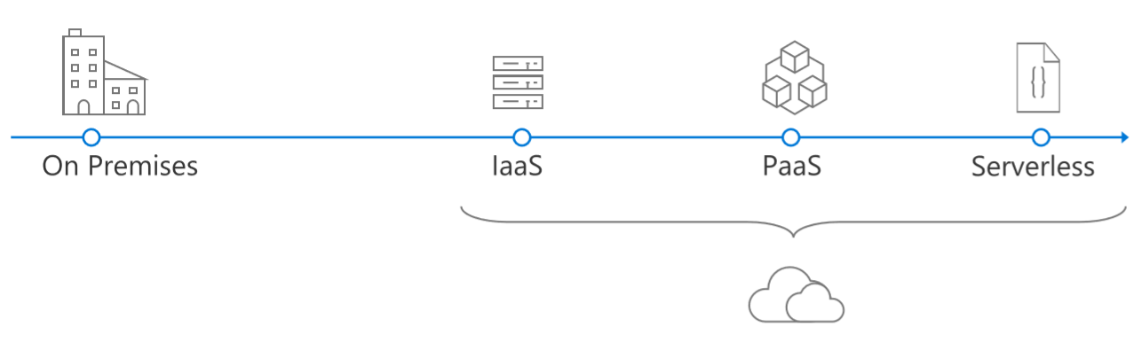
Evolution of Application Platforms

Slide 3
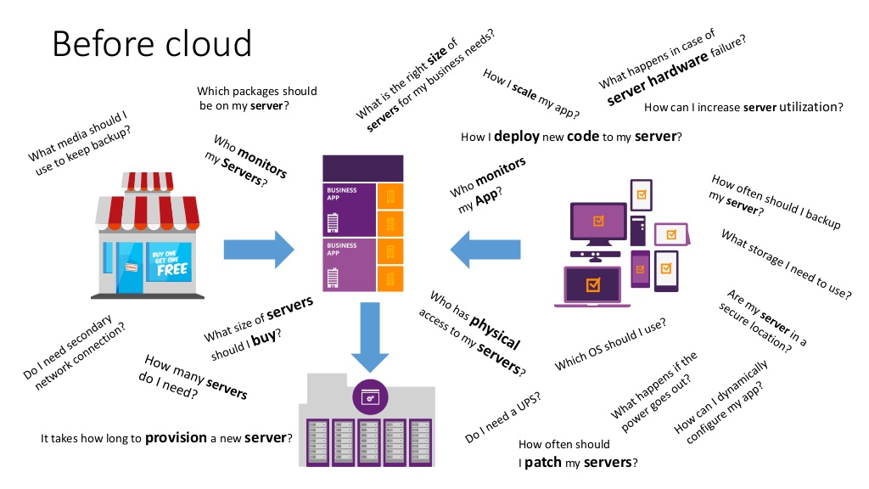

Slide 4
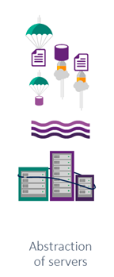
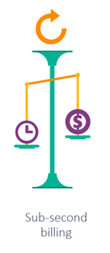
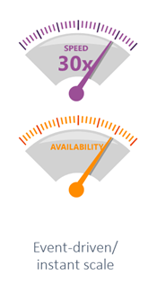
Serverless
No Servers
Not Really?
It does not mean there are no servers involved.
It just means you aren’t managing servers
4

Slide 5
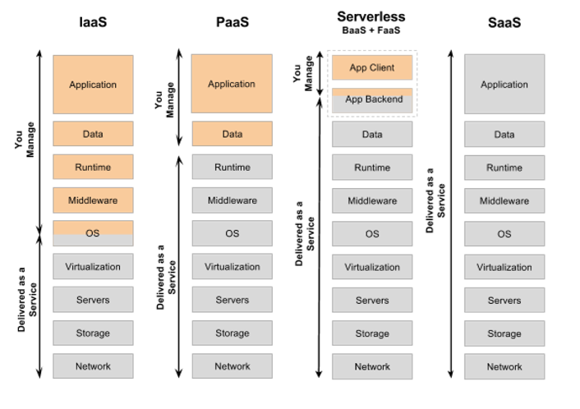

Slide 6
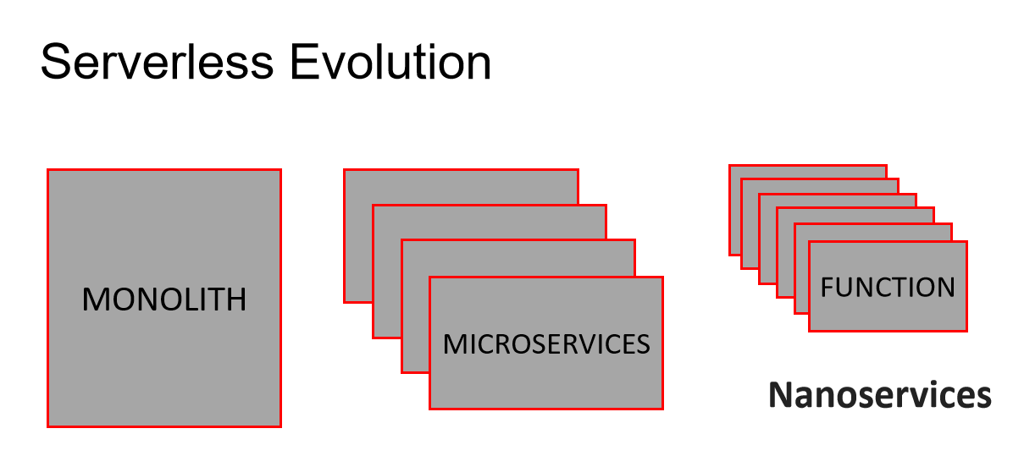

Slide 7

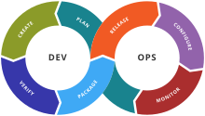

Why Serverless is great?
Notes:
Focus on Business logic
Reduced Time to Market

Slide 8
Serverless Apps Lifecycle
Design
Develop
Deploy
Monitor

Slide 9
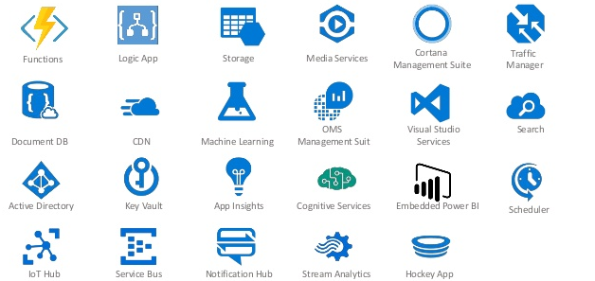
Microsoft Serverless Services

Slide 10
Azure Functions

Slide 11
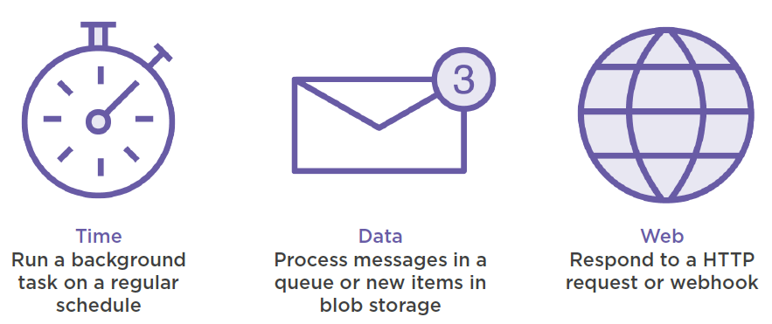
Azure Functions = Events + Code
Function as a Service (FaaS)

Slide 12
Why Azure Functions?
Fully managed compute environment
High reliability
Security
Auto-scaling
Pay-per-use (Consumption plan)
Less boilerplate code to write/maintain
Integrate easily with range of services

Slide 13
Type of Trigger
HTTPTrigger - execution of your code by using an HTTP request
TimerTrigger - Execute cleanup or other task on a predefined schedule
CosmosDBTrigger - added or updated in collections
BlobTrigger - You might use this function for image resizing
QueueTrigger - Respond to messages as they arrive
Run a custom Function manually

Slide 14
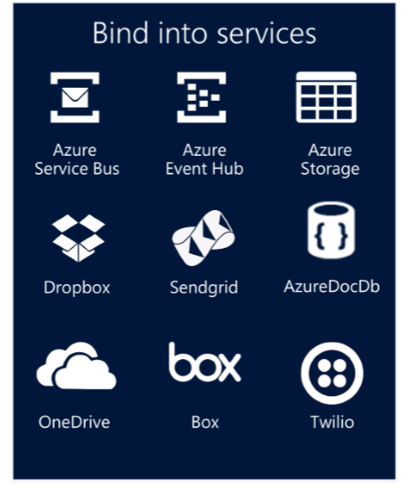
Integration
It integration with other Azure services such as Logic Apps, Event Hub, CosmoDB, Azure Blob Storage, Application Insight, etc.
Notes:
fsdfsdfdsf

Slide 15
Platform and scaling
App Service offers dedicated and dynamic tiers.
Dedicated(App Service Plan) is the existing App Service plan tiers
Basic, Standard, Premium
Pay based on # of reserved VMs
You’re responsible for scale
Dynamic (Consumption Plan)
Pay on number of executions
Platform responsible for scale

Slide 16
Supported Languages
Bash
C#
F#
JavaScript
PHP
PowerShell (yay!)
Python

Slide 17
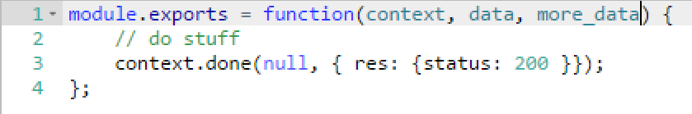
Functions programming concepts
Trigger
Input
Code
Output

Slide 18

Async background processing
Example: Thumbnail resizing
Notes:
Yochay
This is a great opportunity to show Functions and talk/explain the differences → Bindings
If we have time this can be a coding demo
Talk to the scenario – show Contoso Moments?
Create from template and show the end2end demo? → talk about bindings and integration → this

Slide 19
Benefits of “serverless”
“Pinnacle of PaaS compute”
Not just hardware “servers”, but software servers are also managed for you
Focus on business logic, not solving technical problems not core to business
Lower effort to get started makes it easier to experiment (bots, etc.)

Slide 20
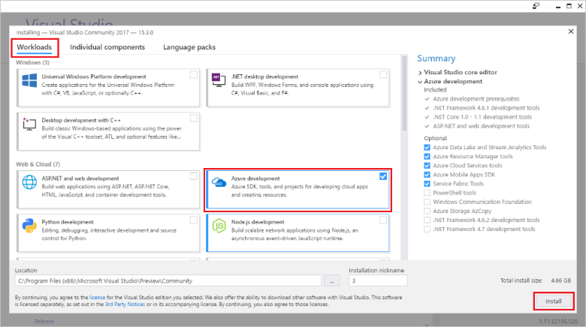
Debugging Azure functions
Prerequisites

Slide 21
Other requirements
An active Azure subscription.
An Azure Storage account.

Slide 22
Demo

Slide 23

Get started and reach out!
Try Azure - https://azure.microsoft.com/en-us/free/
Try Functions – https://functions.azure.com
Try App Service – https://tryappservice.azure.com

Slide 24


Slide 25


